Slide 1
Electronics Lab (Experiment-2)
P . Manoj Kumar
Roll no : 21IE10027

Slide 2
Design and simulation of common emitter amplifier with stable operating point
Objective of the Experiment
Know how to stabilize operating point of a CE amplifier
Constructing an amplifier topology and bias the transistor in appropriate operating point for proper analog operation.
Observe and analyze “small signal” frequency response of the amplifier
Know the practical values of gain and band width of a simple voltage amplifier

Slide 3
Part A: Compare bias point stability of CE amplifier with Fixed-bias and that with Self-bias
Procedure
The resistors of the common emitter amplifier with fixed-bias configuration (circuit-diagram-1)were chosen in such a way that the V_{ce} is around 6V and I_{c} in 1- 2mA current range.
The transistor was replaced with another one having significantly different 𝛽_{F} .
The change in DC operating point of the circuit was observed and analyzed.
The experiment steps 1-3 were repeated for a common emitter amplifier with self-bias configuration (circuit-diagram-2).

Slide 4
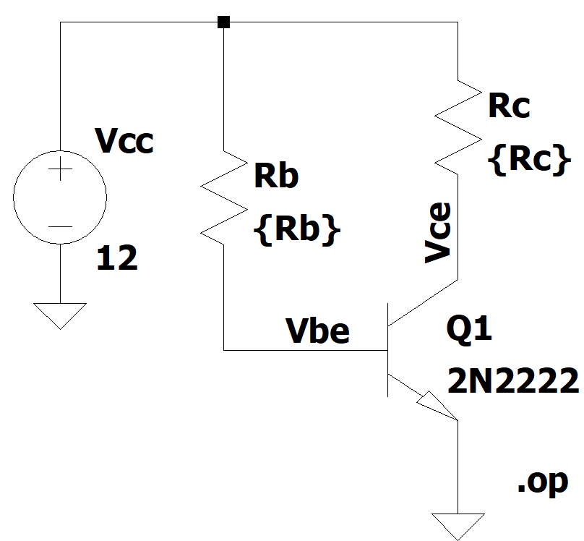
Circuit Diagram-1
Fig-1.1-Circuit with unknown resistors with BJT (2N2222) in fixed-bias configuration

Slide 5
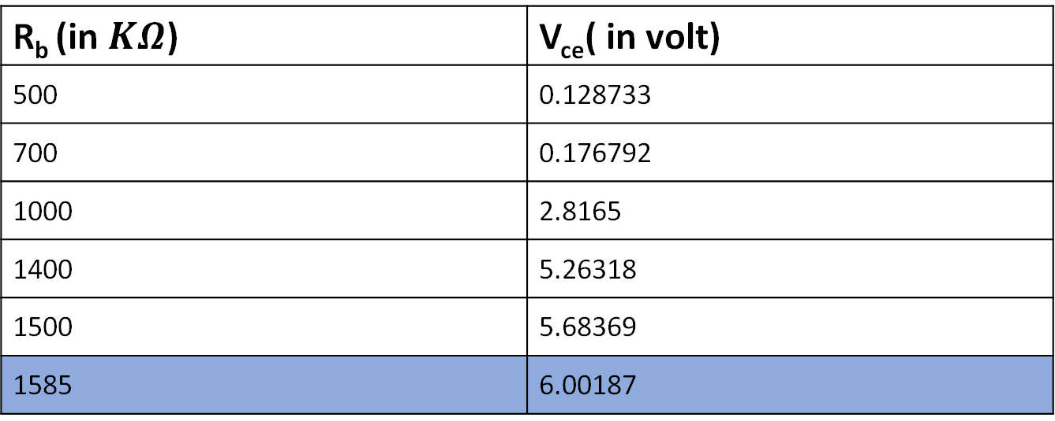

Values of Biasing Resistances
The value of R_{c} wil be nearly = $\frac{\text{V}\text{cc}\text{−}\text{Vc} }{\text{I}\text{c} }= \frac{12−6}{0.0015}=4KΩ$
R_{b} (in $KΩ$) | V_{ce}( in volt)
500 | 0.128733
700 | 0.176792
1000 | 2.8165
1400 | 5.26318
1500 | 5.68369
1585 | 6.00187

Slide 6
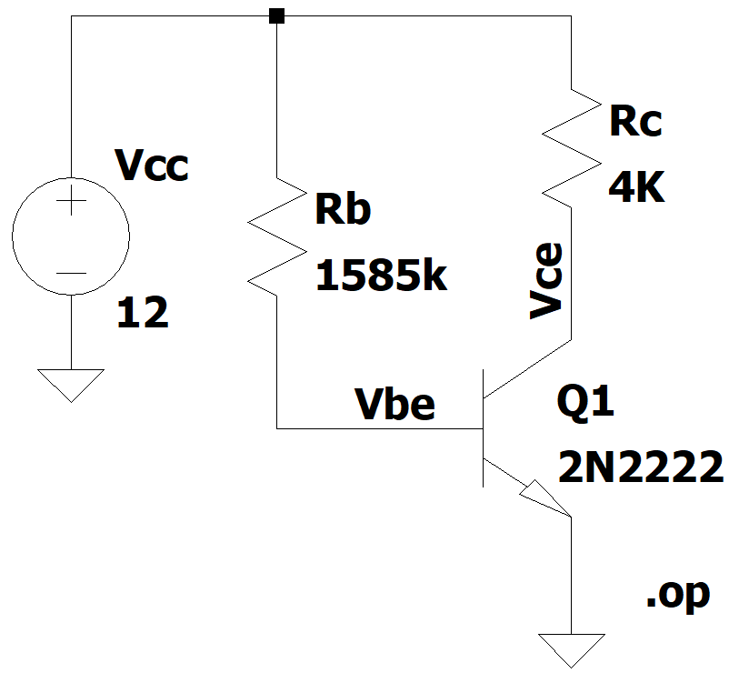
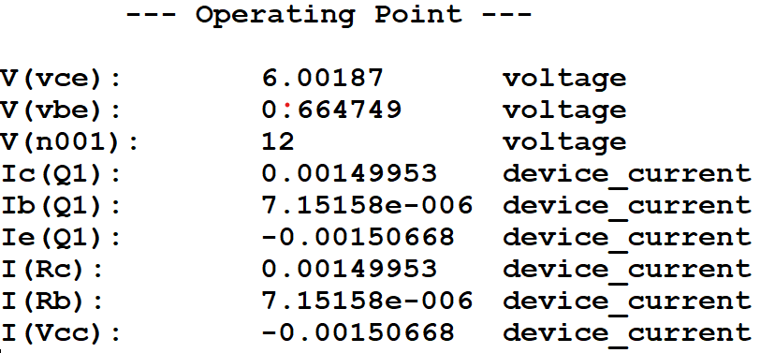
DC Operating Point Analysis
Fig-1.2-Operating point analysis of the circuit with BJT (2N2222) in fixed-bias configuration
V_{ce} = 6.00187V and I_{c} = 1.49953mA

Slide 7
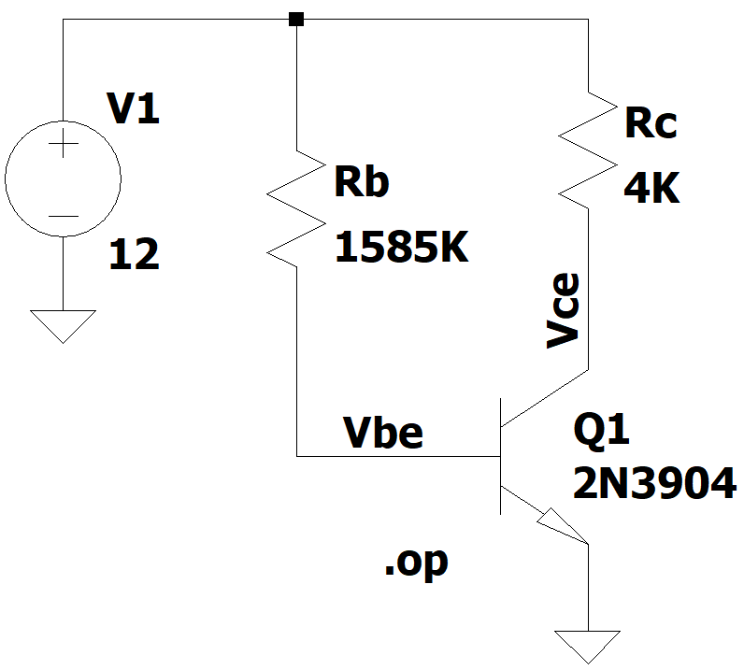
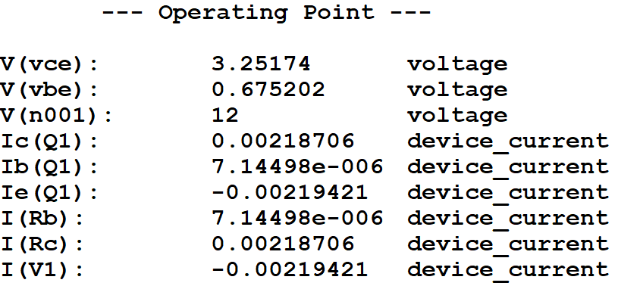
DC Operating Point Analysis
Fig-1.3-Operating point analysis of the circuit with BJT (2N3904) in fixed-bias configuration
V_{ce} = 3.25174V and I_{c} = 2.18706mA

Slide 8
Change in Operating point Analysis
Operating Point Parameters | Circuit with BJT (2N2222) | Circuit with BJT (2N3904)
𝛽 | 200 | 300
V_{ce} (in V) | 6.00187 | 3.25174
I_{c} (in mA) | 1.499 | 2.187
There is a significant change in the DC operating point after the changing the BJT(2N2222) to BJT(2N3904).

Slide 9
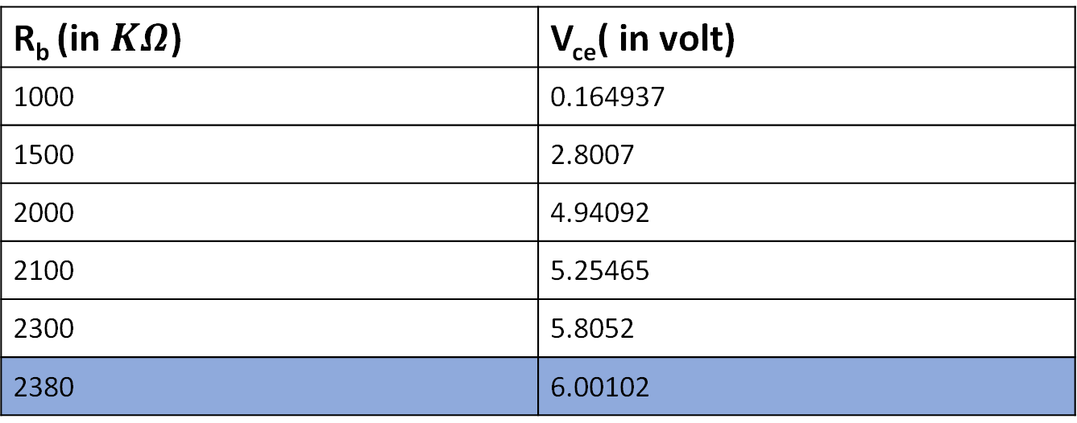

Changing Values of Resistances
The value of R_{c} wil be nearly = $\frac{\text{V}\text{cc}\text{−}\text{Vc} }{\text{I}\text{c} }= \frac{12−6}{0.0015}=4KΩ$
R_{b} (in $KΩ$) | V_{ce}( in volt)
1000 | 0.164937
1500 | 2.8007
2000 | 4.94092
2100 | 5.25465
2300 | 5.8052
2380 | 6.00102

Slide 10

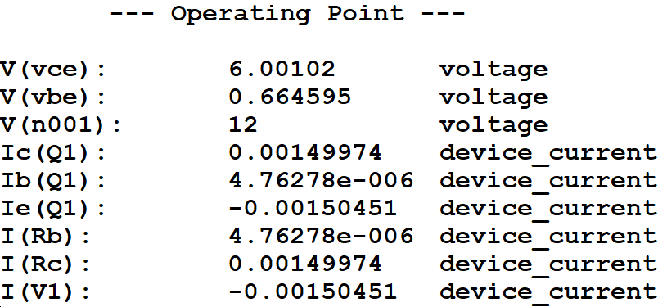
DC Operating Point Analysis
Fig-1.4-Operating point analysis of the circuit with BJT (2N3904) in fixed-bias configuration after changing the values of resistances

Slide 11
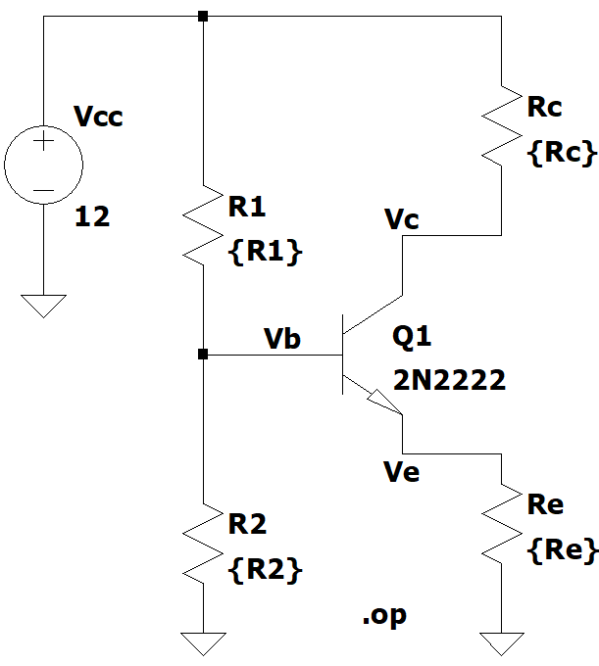
Circuit Diagram-2
Fig-1.5-Circuit in Self-Bias Configuration with unknown resistors with BJT (2N2222)

Slide 12

Values of Biasing Resistances
Generally, V_{B} = $\frac{\text{V}\text{cc}}{3}=4V$
$⇒ \frac{R_{2}}{R_{1}+R_{2}}$ = $\frac{1}{3}$ $⇒$ R₁ = 2R₂
Current through R₁ and R₂ is same ( ≈ 100I_{b} )
$⇒$I_{C} = 1.5 mA $⇒$ I_{B} = $\frac{1.5}{β}$ mA
$⇒$ I_{R1} = I_{R2} = $\frac{150}{β}$ mA
$⇒$ $\frac{\text{V}\text{cc}}{\text{R}\text{1}\text{+}\text{R}\text{2}}$ = $\frac{150}{β}$ mA $⇒$ R₁ + R₂ = $\frac{2β}{25}$K𝛺
From Above two relations ,
R₁ = $\frac{4β}{75}$ K𝛺 , R₂ = $\frac{2β}{75}$ K𝛺

Slide 13
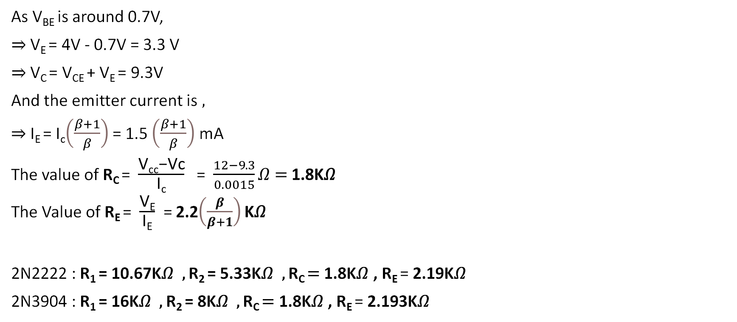
Values of Biasing Resistances
As V_{BE} is around 0.7V,
$⇒$V_{E} = 4V - 0.7V = 3.3 V
$⇒$V_{C} = V_{CE} + V_{E} = 9.3V
And the emitter current is ,
$⇒$I_{E} = I_{c}$\left(\frac{β+1}{β}\right)$ = 1.5 $\left(\frac{β+1}{β}\right)$ mA
The value of R_{C} = $\frac{\text{V}\text{cc}\text{−}\text{Vc}}{\text{I}\text{c}}$ = $\frac{12−9.3}{0.0015}\text{Ω}\text{ = }\text{1.8}\text{K}\text{Ω}$
The Value of R_{E} = $\frac{\text{V}\text{E}}{\text{I}\text{E}}$ = 2.2$\left(\frac{β}{β+1}\right)\text{K}\text{Ω}$
2N2222 : R₁ = 10.67K𝛺 , R₂ = 5.33K𝛺 , R_{C} $\text{= }\text{1.8}\text{K}\text{Ω}$ , R_{E} = 2.19$\text{K}\text{Ω}$
2N3904 : R₁ = 16K𝛺 , R₂ = 8K𝛺 , R_{C} $\text{= }\text{1.8}\text{K}\text{Ω}$ , R_{E} = 2.193$\text{K}\text{Ω}$

Slide 14
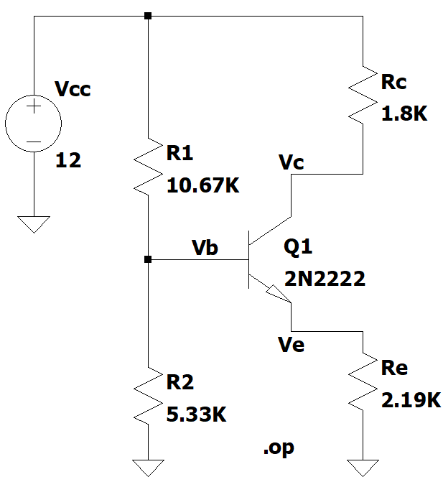
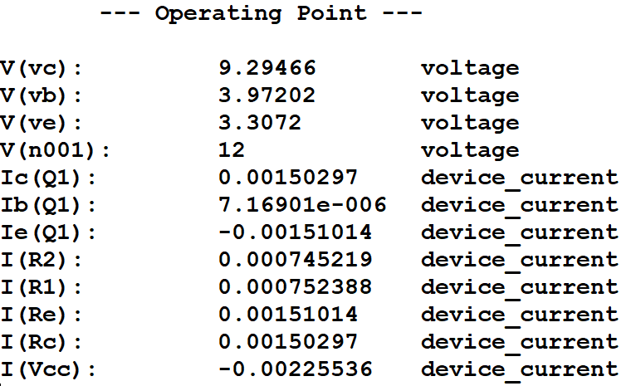
DC Operating Point Analysis
Fig-1.6-Operating point analysis of the circuit in self-bias configuration with BJT (2N2222)
V_{ce} = 5.98746V and I_{c} = 1.5029mA

Slide 15
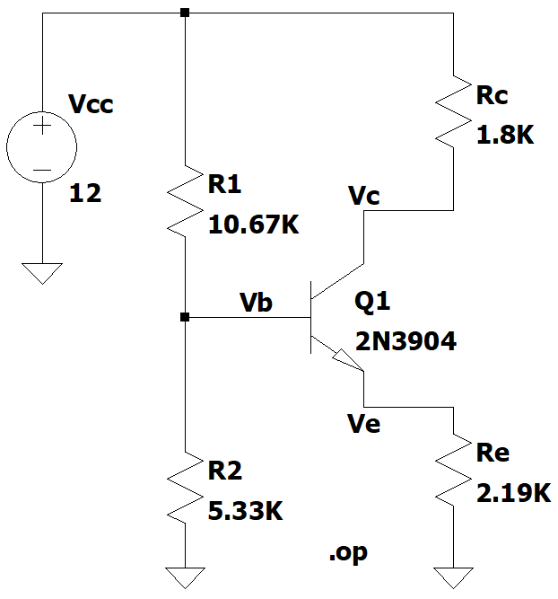
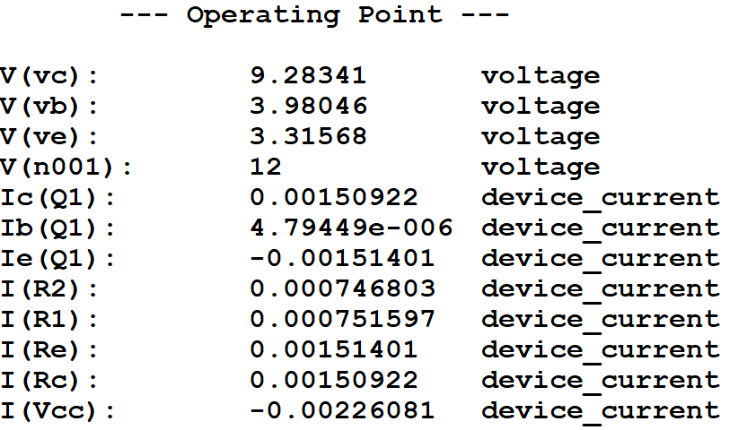
DC Operating Point Analysis
Fig-1.7-Operating point analysis of the circuit in self-bias configuration with BJT (2N3904)
V_{ce} = 5.96773V and I_{c} = 1.50922mA

Slide 16
Change in Operating point Analysis
There is no significant change in the DC operating point after the changing the BJT(2N2222) to BJT(2N3904). Both V_{ce} and I_{c} are almost same.
Operating Point Parameters | Circuit with BJT (2N2222) | Circuit with BJT (2N3904)
𝛽 | 200 | 300
V_{ce} (in V) | 5.99 | 5.96
I_{c} (in mA) | 1.503 | 1.509

Slide 17
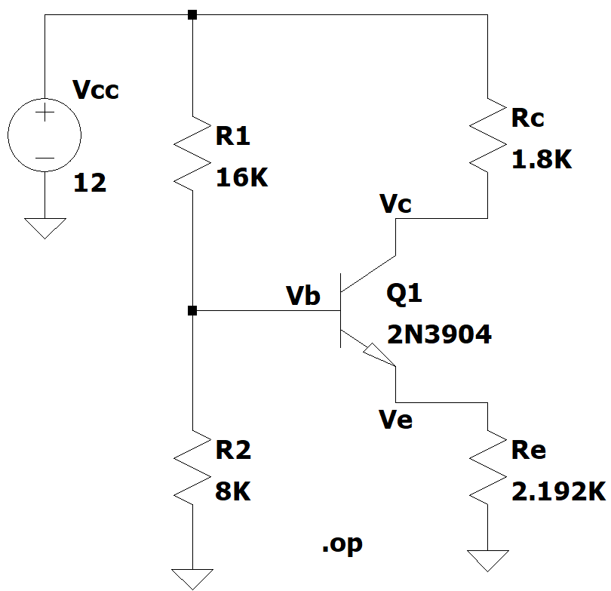
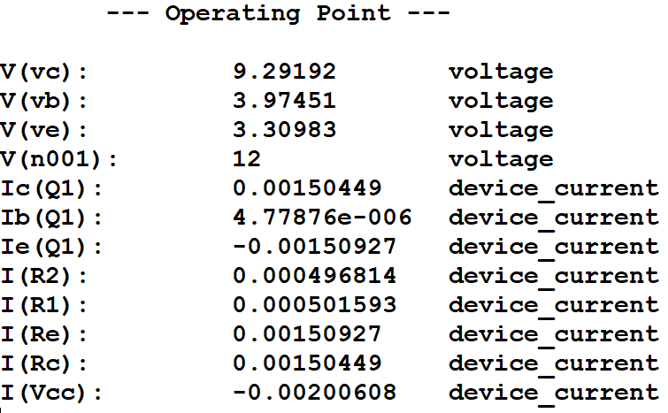
DC Operating Point Analysis
Fig-1.8-Operating point analysis of the circuit with BJT (2N3904) after changing the values of resistances in self-bias Configuration
V_{ce} = 5.982V and I_{c} = 1.504mA

Slide 18
Part B: Design and simulation of a CE amplifier with Self-bias
Procedure
Choose the components of the CE amplifier with self-bias configuration for V_{ce} around 5V and I_{c} in 1-2mA (shown in Fig 2.c).
Observe the gain and phase response of the amplifier over a wide range of frequency [say, 20Hz to 1MHz].
Analyze the observed frequency response and compare it with theoretical calculation (based on values of transistor parameters and that of components).

Slide 19
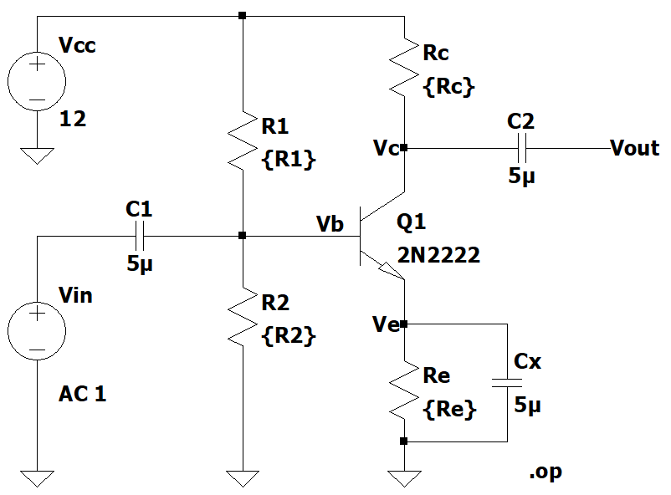
Circuit Diagram
Fig-1.9-Circuit in Self-Bias Configuration with unknown resistors with BJT (2N2222) and coupling capacitors

Slide 20
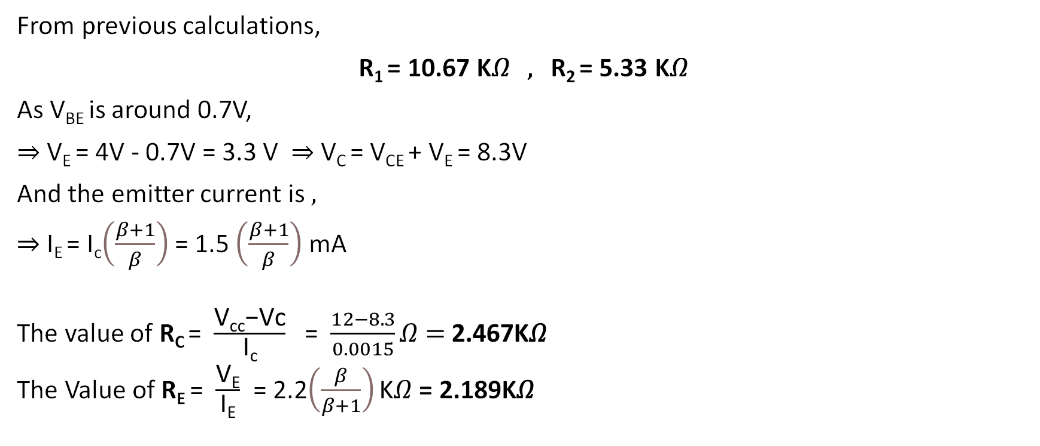
Values of Biasing Resistances
From previous calculations,
R₁ = 10.67 K𝛺 , R₂ = 5.33 K𝛺
As V_{BE} is around 0.7V,
$⇒$V_{E} = 4V - 0.7V = 3.3 V $⇒$V_{C} = V_{CE} + V_{E} = 8.3V
And the emitter current is ,
$⇒$I_{E} = I_{c}$\left(\frac{β+1}{β}\right)$ = 1.5 $\left(\frac{β+1}{β}\right)$ mA
The value of R_{C} = $\frac{\text{V}\text{cc}\text{−}\text{Vc}}{\text{I}\text{c}}$ = $\frac{12−8.3}{0.0015}\text{Ω}\text{ = }\text{2.467}\text{K}\text{Ω}$
The Value of R_{E} = $\frac{\text{V}\text{E}}{\text{I}\text{E}}$ = 2.2$\left(\frac{β}{β+1}\right)\text{K}\text{Ω}$ = 2.189K$\text{Ω}$

Slide 21
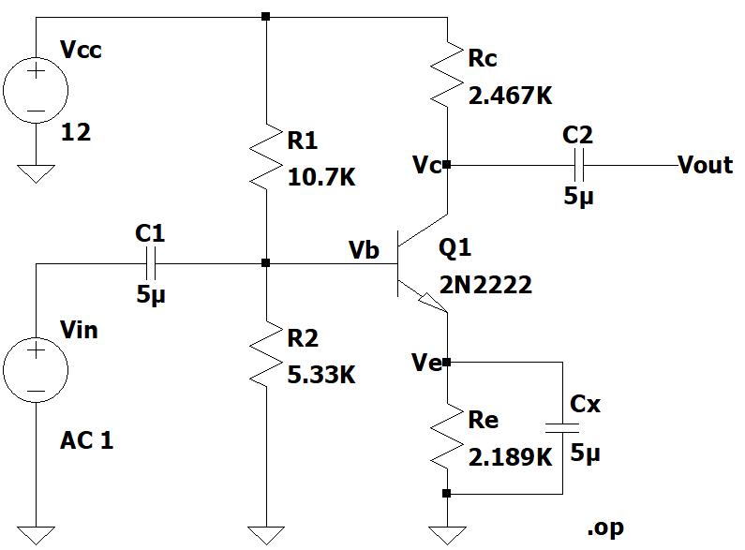
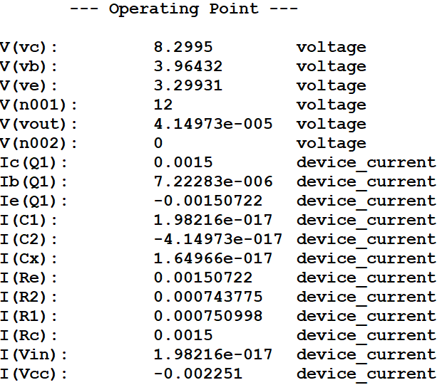
DC Operating Point Analysis
Fig-1.10-Operating point analysis of the circuit in Self-Bias Configuration with unknown resistors with BJT (2N2222)
and coupling capacitances V_{ce} = 5.00019V and I_{c} = 1.5mA

Slide 22
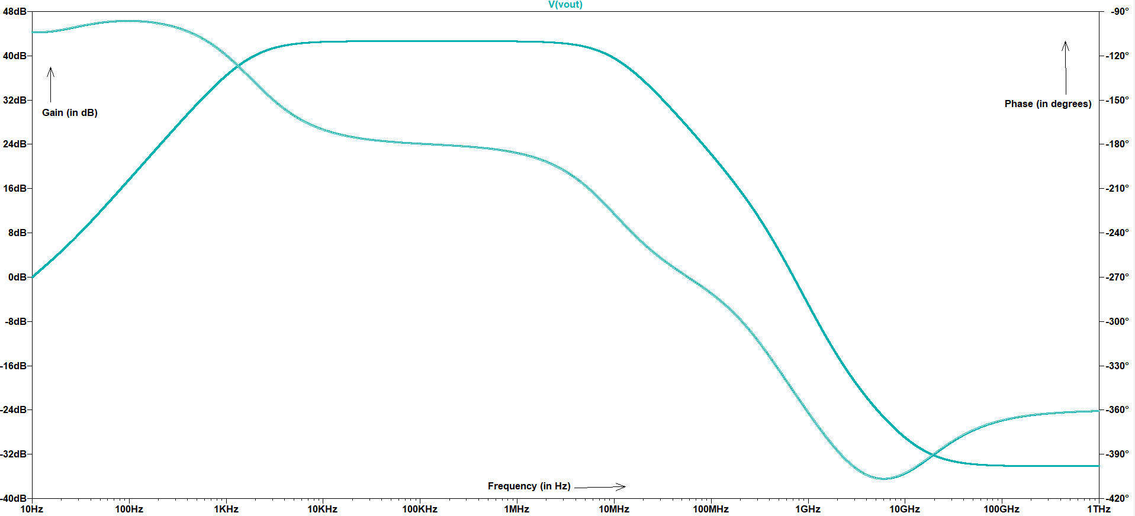
Gain and Phase Response of the Amplifier
Fig-1.11- Small signal AC analysis of the common emitter amplifier

Slide 23
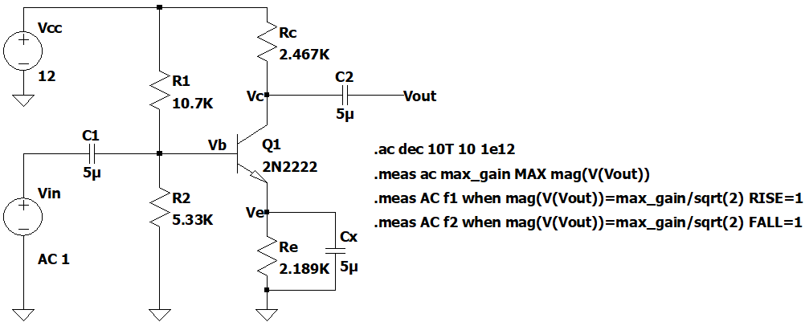
Observed Pole Frequencies
Fig-1.12-Circuit Diagram for calculation of poles
max_gain: MAX(mag(v(vout)))=(42.6434dB,0°) FROM 10 TO 1e+012
f1: mag(v(vout))=max_gain/sqrt(2) AT 1781.33 (First Pole Frequency)
f2: mag(v(vout))=max_gain/sqrt(2) AT 9.83598e+006 (Second Pole Frequency)

Slide 24
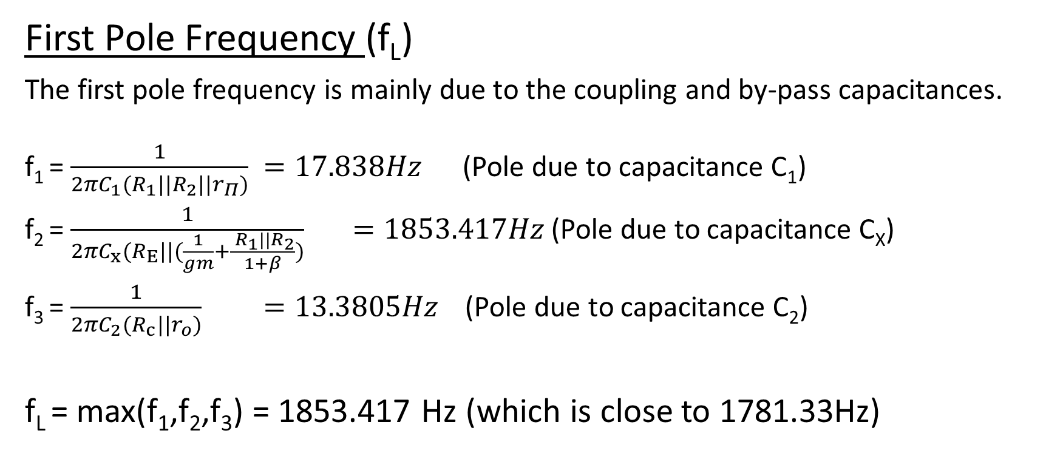
Calculation of Pole Frequencies
First Pole Frequency (f_{L})
The first pole frequency is mainly due to the coupling and by-pass capacitances.
f₁ = $\frac{1}{{{2πC}_{1}(R}_{1}||R_{2}||r_{Π})} =17.838Hz$ (Pole due to capacitance C₁)
f₂ = $\frac{1}{{{2πC}_{x}(R}_{E}||(\frac{1}{gm}+\frac{{ R}_{1}||R_{2}}{1+β})} =1853.417Hz$(Pole due to capacitance C_{X})
f₃ = $\frac{1}{{{2πC}_{2}(R}_{c}||r_{o})} =13.3805Hz$(Pole due to capacitance C₂)
f_{L} = max(f₁,f₂,f₃) = 1853.417 Hz (which is close to 1781.33Hz)

Slide 25
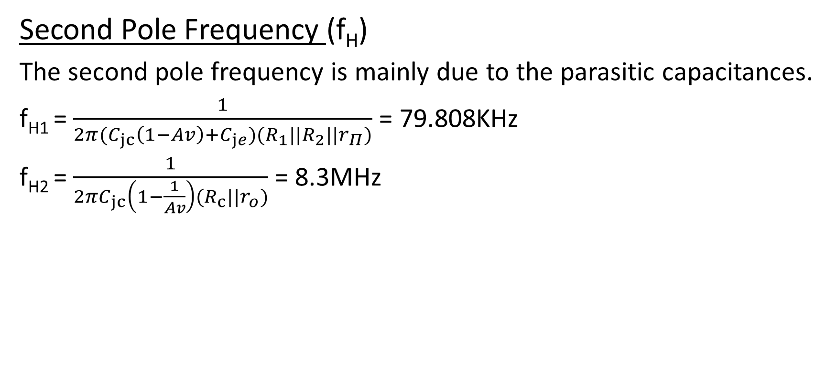
Calculation of Pole Frequencies
Second Pole Frequency (f_{H})
The second pole frequency is mainly due to the parasitic capacitances.
f_{H1} = $\frac{1}{{{2π(C}_{jc}\left(1−Av\right)+C_{je})(R}_{1}||R_{2}||r_{Π})}$ = 79.808KHz
f_{H2} = $\frac{1}{{{2πC}_{jc}\left(1−\frac{1}{Av}\right)(R}_{c}||r_{o})}$= 8.3MHz

Slide 26
Observations
Self-bias configuration of common emitter amplifier is the most stable configuration, as change in beta of the transistor doesn’t effect the operating point much, keeping the amplifier in a stable operating point.
The by-pass capacitor is generally used to increase the gain at high frequencies making the R_{E} short.

Slide 27
Thank You !

